Slide 1
AD Some AI
Git push –force
EagleHacks 2025 – Daniel Kareh, William Murphy, William Ward, David West

Slide 2
An innovative platform that streamlines the ad creation process by leveraging artificial intelligence. Inspired by Eightpoint’s company challenge.
Notes:
Software as a service, empower companies and organizations to quickly get advertisements out there and in the world. Our product aims to streamline advertisement creation process by utilizing AI.

Slide 3
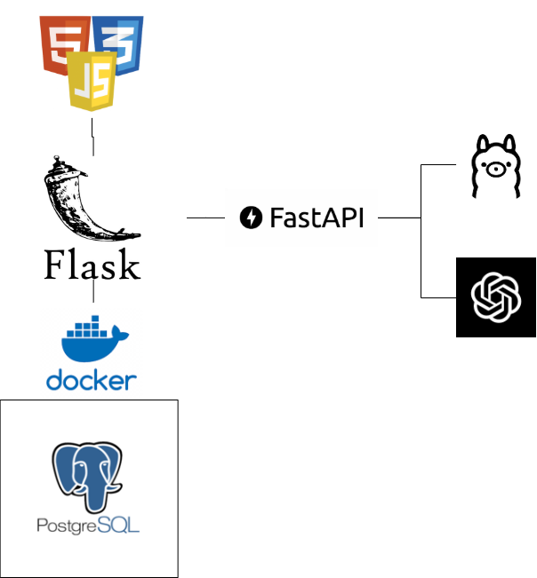
Architecture
PostgreSQL database storing user information
FastAPI-based server for generating ads with OpenAI
Flask-based web server for multi page application
Docker Containerization
Ollama local AI
OpenAI ChatGPT 4.0mini
Notes:
Tech stack, traditional web interface connects to a python flask backend. We utilize docker to host our postgres database, making deployment and backing up of user data super easy. The flask backend utilizes our custom fast api, which is used to interact with the Ollama and OpenAI APIs for AI integration.

Slide 4
PostgreSQL Database
Name | Type
user_id | bigserial
username | varchar(256)
pw_hash | bytea
salt | bytea
api_key | text
As of now, just one table to store user information
Notes:
User IDs assigned sequentially
Usernames required to be unique and non-empty
`bytea` means byte array
Salts are randomly generated in a cryptographically secure way
API keys are generated in the same way except they’re URL safe ”plain” text

Slide 5
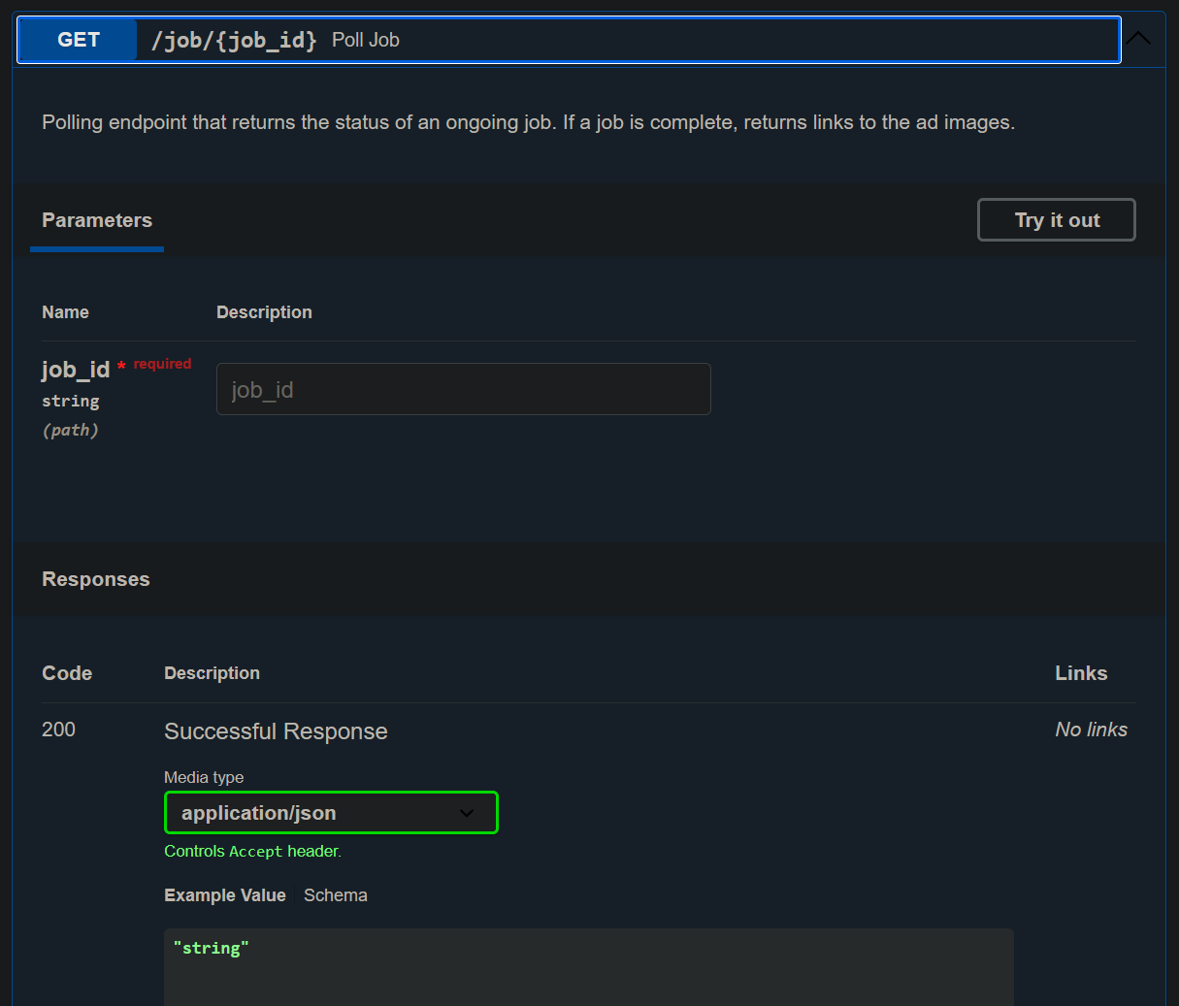
FastAPI
Framework for quick API creation.
Our Endpoints:
POST /new_job -> Creates a new job
GET /job/{job_id} -> Polling for job status
results when completed results
Notes:
David

Slide 6
Flask server
Multipage application
Routes:
GET /
POST /login
POST /register
GET /logout
POST /regenerate_api_key
GET /dashboard
GET, POST /new_job
GET /check_status
GET /market_data_viewer
GET /marketing_data.csv
Written in Python
Serves web pages
Communicates with FastAPI
Manages security
Notes:
Will

Slide 7
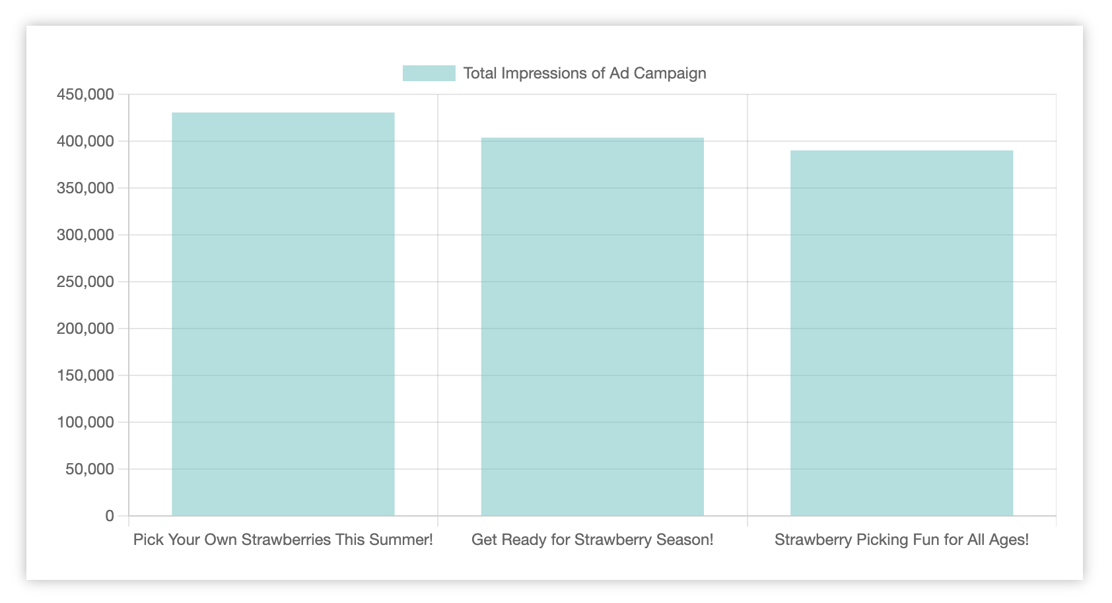
Data Analytics and Campaign Metrics
Responsive and Interactive Data Visualization
Notes:
Data in our charts was generated during one of the first successful run of our prompt
Ofc it’s a simulation due to time limitation
It would be impossible to run ad campaigns
Data is based on high level information
Impressions, clicks , cost , cost per click
Important to Due to applications generating multiple ads its important to judge how the audiences response

Slide 8
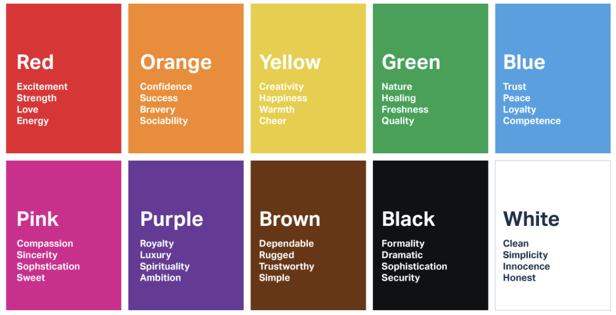
Pick 3 “moods” for campaign cohesiveness
For each campaign
Generate a campaign
Title
Description
Key Message
Generate ad copy
Highlight
Body text
Call-to-Action
Generate ad image
Using campaign title/description/message
Color scheme from mood
Combine elements in a template

Slide 9
Example Inputs
Product: Arthroscopy
Audience: People over the age of 60
Goal: Awareness of improvement of QOL

Slide 10

Example Outputs

Slide 11
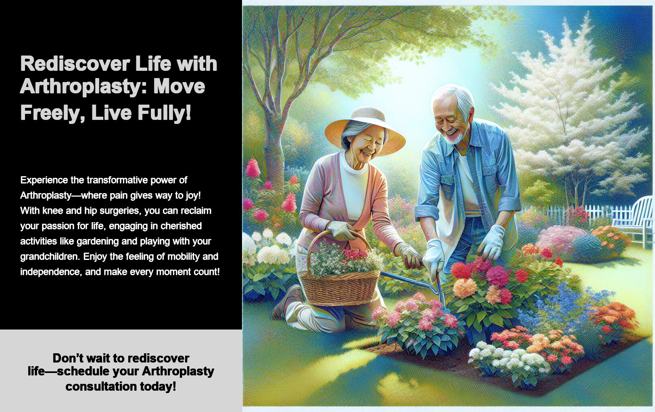

Example Output 2

Slide 12
Example Inputs
Product: Coffee
Audience: Women, age 18 - 35
Goal: Awareness of health benefits

Slide 13

Example Outputs

Slide 14
Example Output 2

Slide 15

Example Output 3

Slide 16
Live Demo
Self Hosted Web Server
73.23.181.62
No time for DNS ☹
Questions?

Slide 17
Thank you!
Git Push --Force

